Slide 1
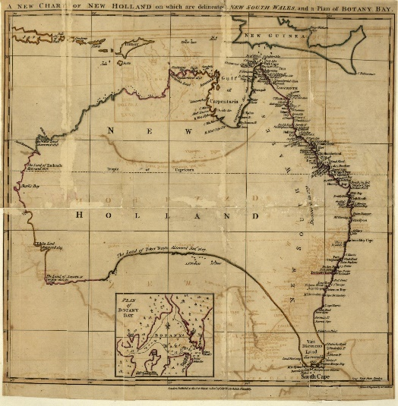
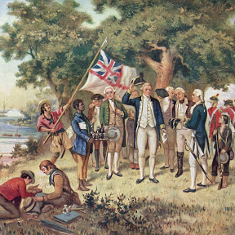
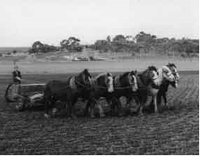
History of Australia
Penal Colony (convicts)
1770
1788
1800s
1851
1901
Mapping the East Coast
40000-70000 Colyears ago (Australian Aborigines)
1606 first landing by Europeans
1770 Captain Cook…. View to colonization
1788 Penal Colony
Colonization
Agriculture
Start of the gold rush
Federation

Slide 2
Early work
https://youtu.be/7i-bVWXAovw

Slide 4
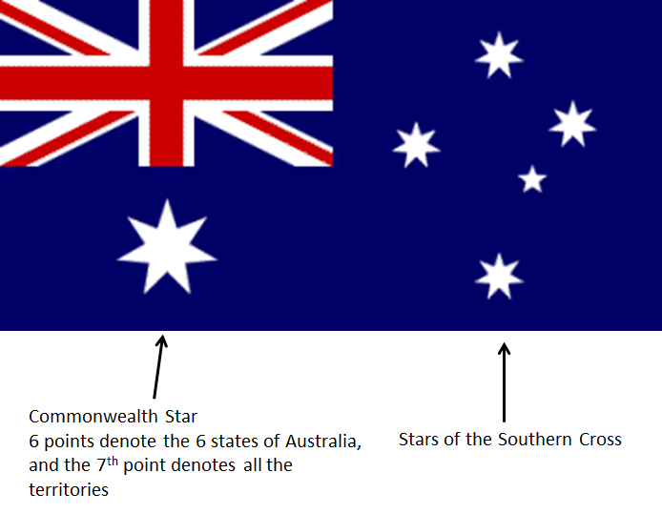
Union Jack

Slide 5
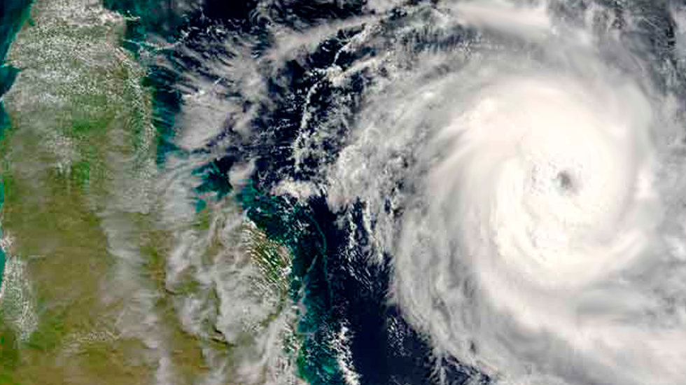

Slide 6
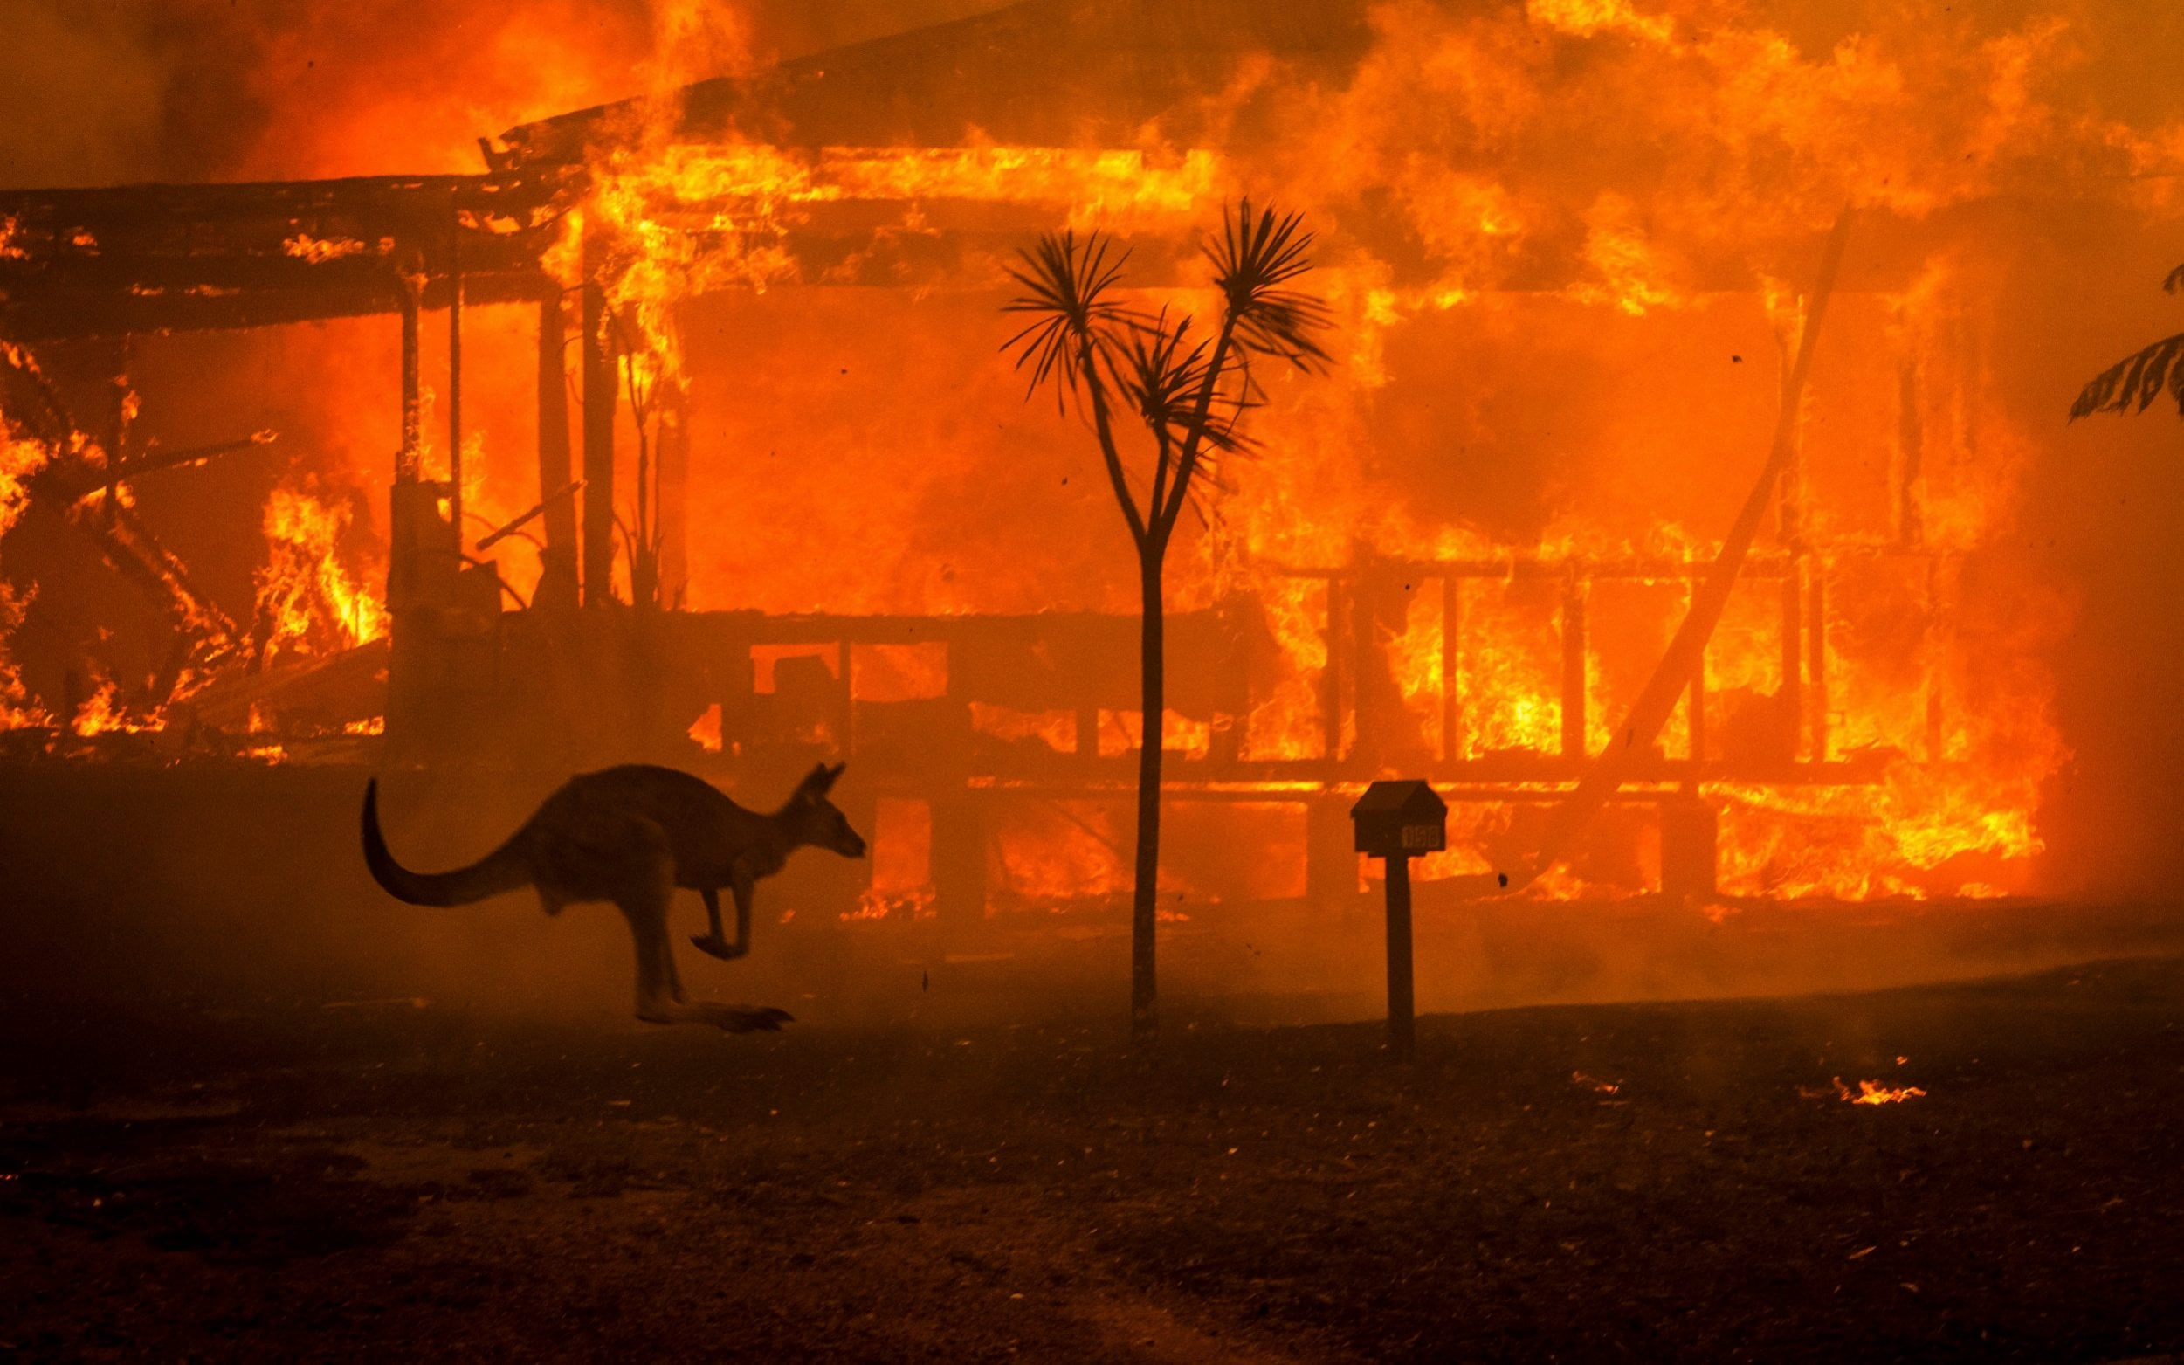

Slide 7
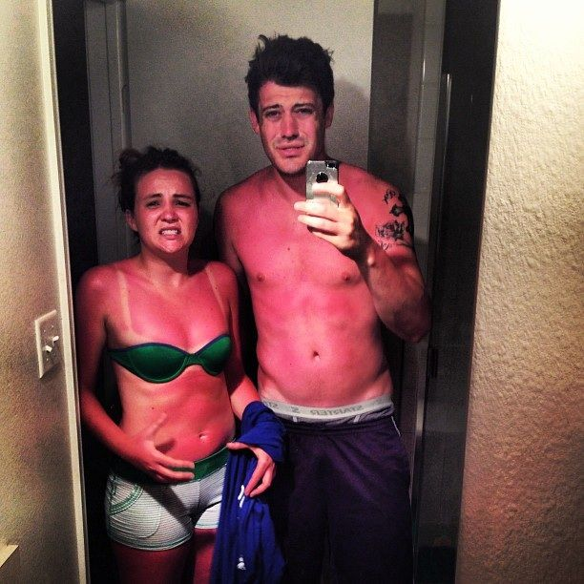
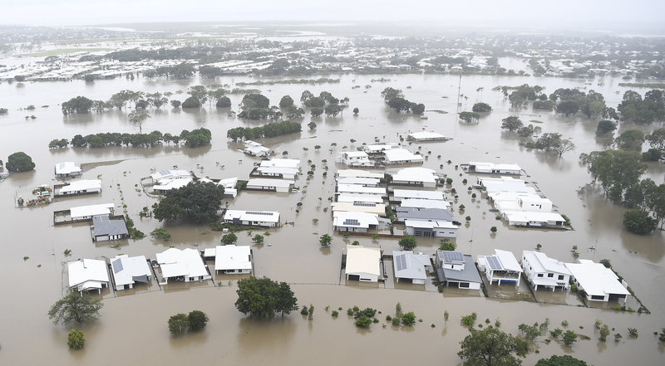
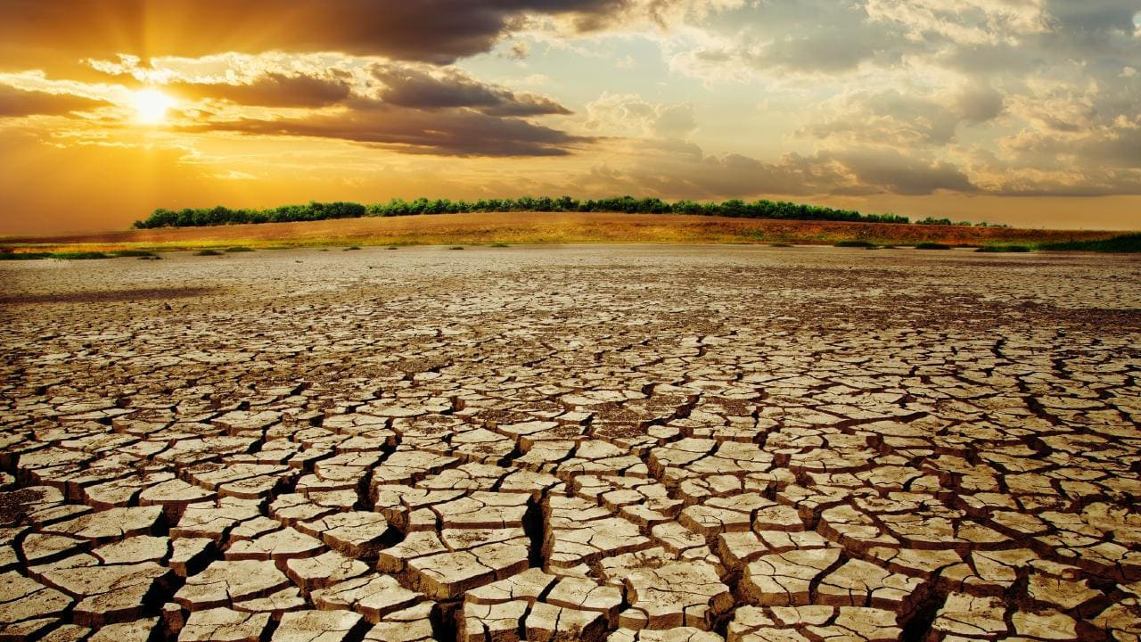

Slide 8
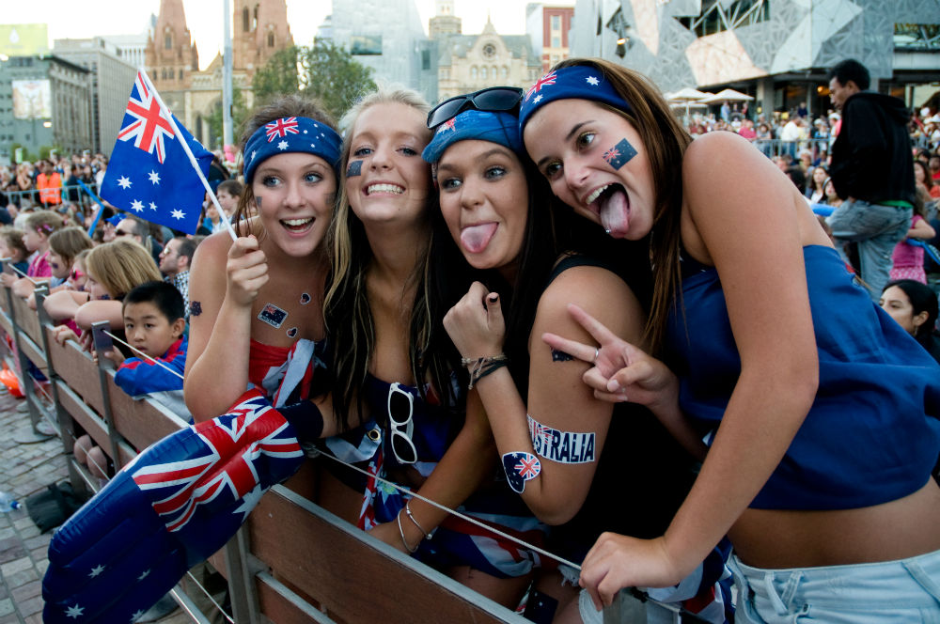
What does it mean to be Australian
https://youtu.be/MISM2funmAw

Slide 10
Famous Australian Brands

Slide 11
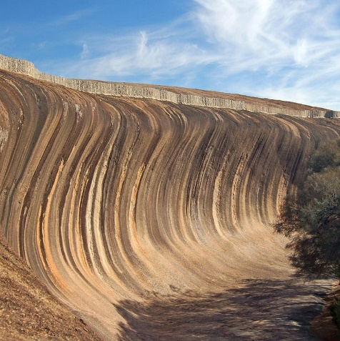
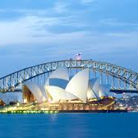
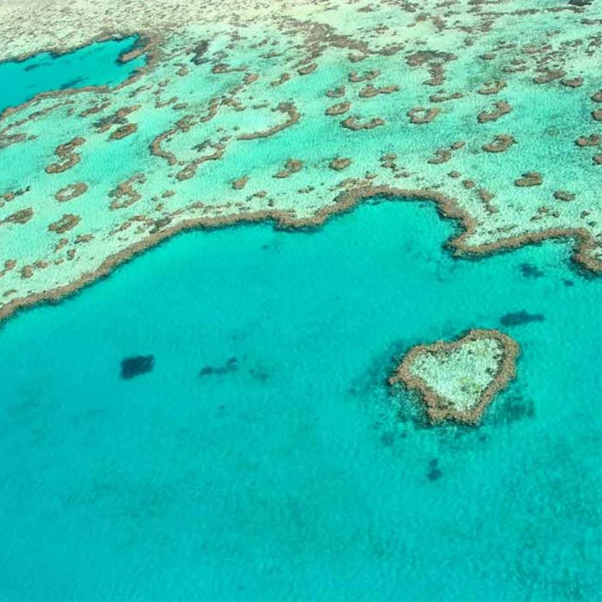
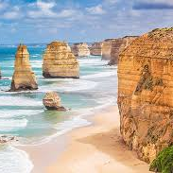
Landmarks
In Australia
Natural Wave (WA)
Sydney Opera House
The Great Barrier Reef
12 Apostles
Ayres Rock

Slide 13
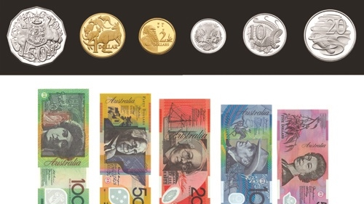
$1 Australian = 21.12NT (August 26th 2020)

Slide 14
Exams for university entry
https://youtu.be/BWF2jw5aRu4

Slide 15
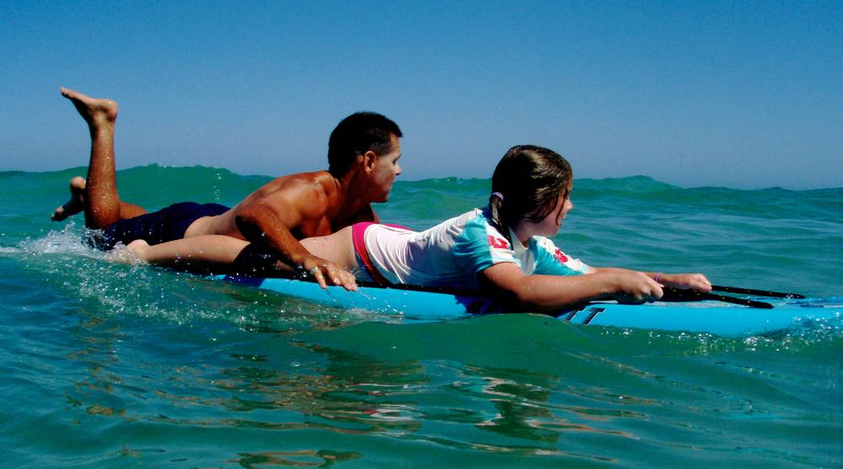
Australia Day
Bondi Rescue
https://youtu.be/kgaw3YSXsSo

Slide 16
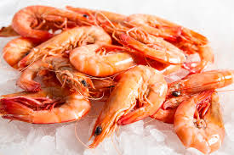
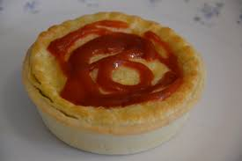
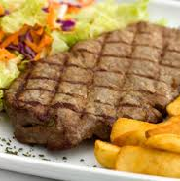
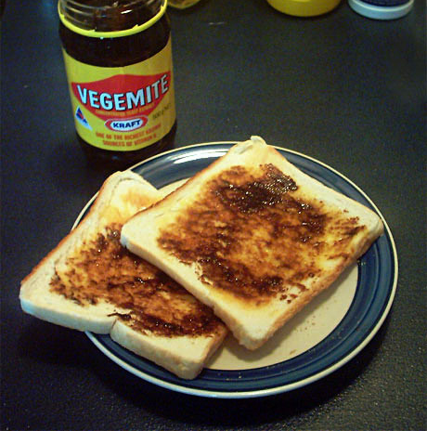
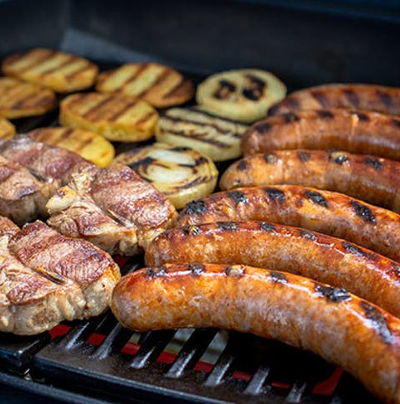
https://youtu.be/RLCXthUAG6M

Slide 17
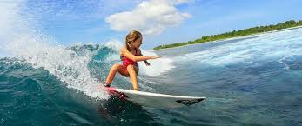
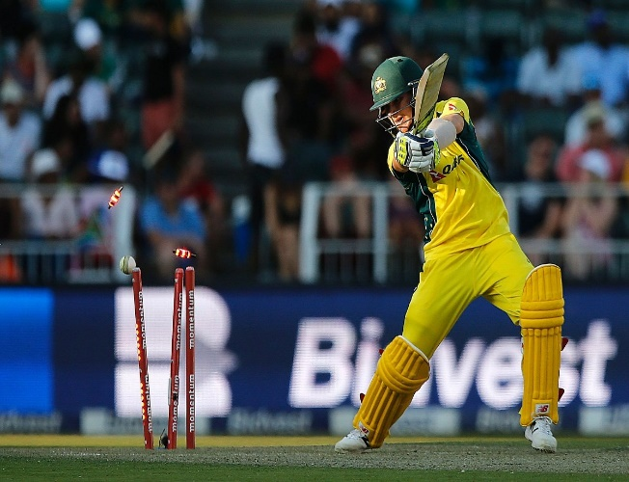
https://youtu.be/XMZYZcoAcU0
https://youtu.be/iqOVdzSWjJc
https://youtu.be/XFvdkmuvY7s

Slide 18
